Slide 1

Phonics and Early Reading
Welcome!

Slide 2
Aims
To introduce the main features of our phonics programme – Unlocking letters and Sounds
To give advice on how best to support your child at home in the early stages of reading and writing

Slide 3
We love reading!
We read books: both fiction and non-fiction, poetry and rhymes to our children every day.
Reading for pleasure
Reading for information

Slide 4
What is Phonics?
Phonics is the main method we use to teach children to read and write
It gives them the tools to break words down into their sounds and blend these together to read- decoding
We blend to read, we segment to spell

Slide 5
How is Phonics taught?
It is taught every day for 20 minutes and all children are assessed half termly
In each lesson children rehearse GPCs they already know, learn a new one and read and write words with the new GPCs in
Children are taught to use pure sounds – no schwa

Slide 6
So what is a schwa?
the weak vowel sound in some syllables that is not emphasized, such as the first syllable of "about" and the second syllable of "given", or the ə symbol that represents this sound
In phonics it is the sound that is sometimes made when the phoneme is pronounced with an ‘u’ on the end. It is not useful or helpful when learning to read and write with phonics.

Slide 7
Reading at school
Reading is taught in our phonics lessons.
In the Spring Term children have a guided reading lesson twice a week, where they read independently in a group. This is where we teach the skills of reading (how to use prosody, what punctuation does for us, the meaning of new words)
Children are heard read 1:1 with a teacher every other week.

Slide 8
Reading at home
Children will bring home two books: one is a story/non-fiction for you to read to your child, the other is their reading book for them to read to you.
They need to read their reading book all the way through three times.

Slide 9
Tips for Reading at home
5 – 10 minutes
Choose a time that works for you and your family
Be positive and celebrate successes
Encourage them to point to the graphemes
Encourage them to say the sounds and blend them together
Be patient and let them try and work it out
Remind them to read common exception words by sight
Try to finish the book in one sitting if possible

Slide 10
Handwriting and letter formation
We teach letter formation within our phonics lessons and in discrete handwriting lessons.
Children are taught a patter to go alongside the letters they are forming.
They are taught to hold a pencil correctly.
We practise both gross motor and fine motor skills to prepare for handwriting.

Slide 11
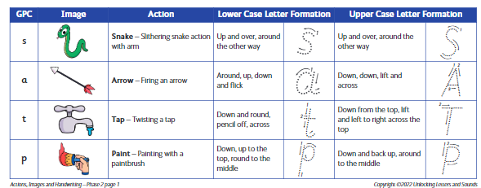
Handwriting and letter formation
Children need to form letters correctly every time they write. Unlearning incorrect letter formation is very difficult to do!

Slide 12
Phase 1
During phase 1 of Unlocking Letters and Sounds children build their phonemic awareness through different games
They practise listening for sounds in the environment, playing and hearing sounds using musical instruments and taking part in rhyming stories and nursery rhymes.

Slide 13
How you can help
Read lots of stories including rhyming ones to your child
Sing nursery rhymes with your child
Clap rhythms and ask your child to copy them
Play with words – make up silly rhymes together

Slide 14
Rhyming books to share with your child

Slide 15
Phase 2
During phase 2 children are introduced to a progressive sequence of GPCs (grapheme, phoneme correspondences)
s a t p i n m d g o c k ck e u r h b f, ff , ll
We teach each phoneme (sound) using a gesture as well as the sound. Children learn to write the grapheme (lower case, then later on Capital letters).

Slide 16
Phase 3
j,v,w,x
y,z,zz,qu
Digraphs: ch, sh, th, ng, oo, oa, ow, ee, ai, ar, oi, ur, or, ir, er
Trigraphs: ear, air, igh, ure
We also make sure children know the names of the letters as well as the sounds.

Slide 17
Tricky words CEWs
Tricky words are words that usually cannot be decoded using synthetic phonics so they are taught as sight words.
During each phase the children are introduced to some tricky words which they have to learn how to read and write.
The first CEWs are? I no go the to into

Slide 18
Glossary !
Grapheme: the written form of the letter
Phoneme: the sound the grapheme(s) make
Digraph: a phoneme made of 2 graphemes e.g. ee as in feet
Trigraph: a phoneme made of 3 graphemes, e.g. igh as in light
Segment: the art of breaking a word up into its smallest sounds (or phonemes)
Blend: putting the sounds back together to make a word
CEWs – Common Exception Words (words that cannot be decoded/sight words)

Slide 19
