Slide 1
EYFS
Welcome to the Foundation Stage – Working together
1

Slide 2
Aims
Overview of the EYFS
Sharing assessment
Working together
Answer any questions you may have
2

Slide 3
Foundation Stage at Long Sutton
We recognise that every child is unique and that all children learn and develop in different ways.
We want to work in partnership with parents and carers - share assessment and progress and celebrate success together.
3

Slide 4
Principles of the Early Years Foundation Stage
A Unique Child + Positive Relationships +
Enabling Environments
= Learning and Development
4

Slide 5
How Children Learn
Playing and Exploring
Finding out and exploring
Playing with what they know
Being willing to have a go
Active Learning
Being involved and concentrating
Enjoying achieving what they set out to do
Keeping trying
Creating and Thinking Critically
Having their own ideas
Making links
Choosing ways to do things
5

Slide 6
Foundation Stage Curriculum
Prime Areas of learning:
Physical Development
www.youtube.com/watch?v=R8PIXqp3JpA
Personal, Social and Emotional Development
Communication and Language
6

Slide 7
Specific Areas of the curriculum
Maths
Literacy
Understanding the World
Expressive Arts and Design
7

Slide 8
Maths: number How you can help
Count with your child forwards and backwards up to 10, then 20 and then 100
Share objects/food – beginning of division
Count objects, actions and sounds making sure your child is counting one at a time accurately
Use money in role-play – real coins are better than play money
Practise reading and writing numbers and matching them to quantities
Watching Number Blocks with them!
8

Slide 9
Spatial reasoning
Notice and make repeating patterns together
Notice patterns and shapes (both 2d and 3d) in the environment
Measure time, length, height and weight together
Talk about where things are in space in relation to each other
Build with lego, blocks carboard boxes
9

Slide 10
Literacy – reading and writing
Read with your child as often as possible – both reading books and story books/non-fiction books
Sing nursery rhymes/action rhymes
Look at print together in the environment
Let them see you reading and writing
Make lists together – jobs to do/shopping
Write post-it notes to them
Give them reasons to write - letters, postcards, lists
Practise reading and writing the sounds and tricky words they know
Help develop fine motor skills – cutting, drawing, colouring, small lego, threading, pouring, mixing etc
10

Slide 11
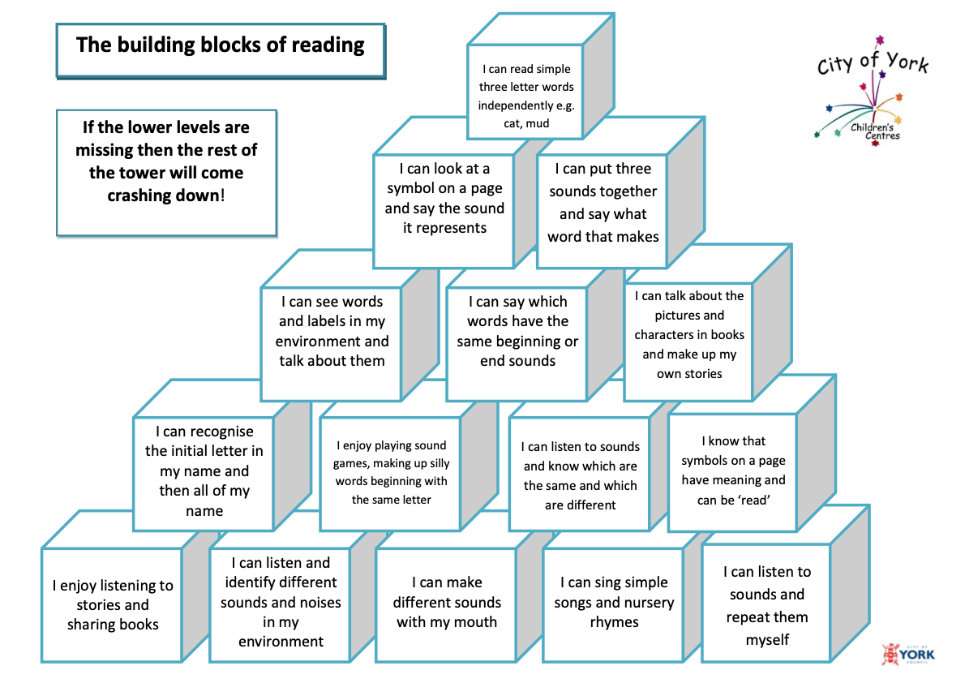
10

Slide 12
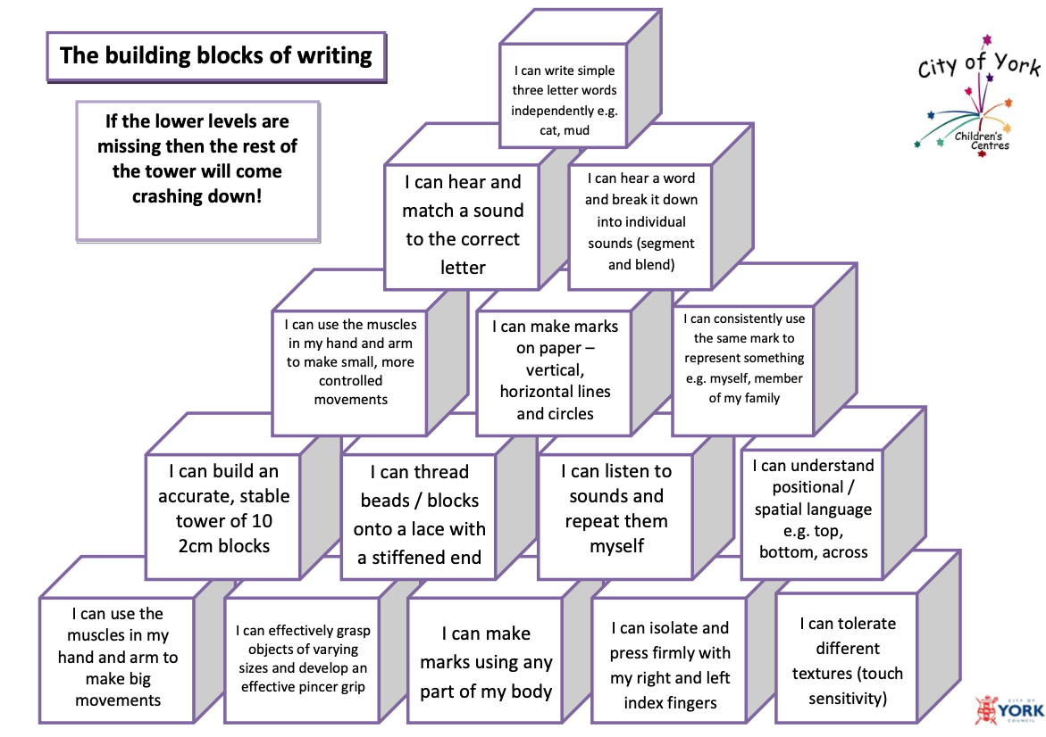
Literacy
10

Slide 13
Understanding the World How you can help
Let us know if your child is using any ICT at home: ipad/phone/tablets/computer games
Talk to your child about internet safety
Talk about the natural world – changing seasons, food growing, plants and animals and humans – whatever they are interested in!
Talk about the past, especially your family history
Talk about other cultures using story books to help.
11

Slide 14
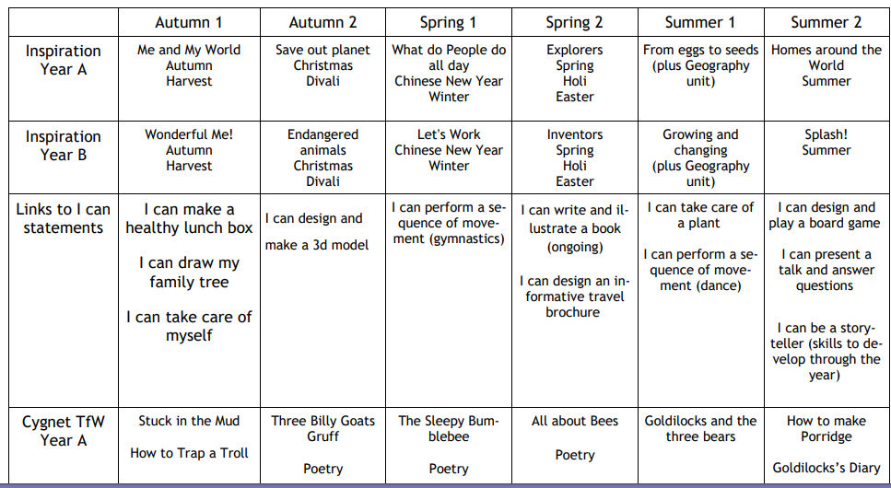
Our Curriculum
11

Slide 15
Assessment
Children are assessed through observations: we watch children as they work and play, talk to them about what they are doing and we interact with them through adult-directed and child initiated play.
We record these observations using photos, note taking, images of the children’s work and more formal assessments (e.g. phonics and reading assessments).
12

Slide 16
Assessment
At the beginning of their reception year children will take part in the baseline assessment
At the end of their Reception year children will be assessed against the Early Learning Goals – 17 statements that cover the Early years curriculum.
12

Slide 17
Learning Journals
How you can help:
Give us some examples of learning that is happening at home- this can include photos with a comment about what they have learnt/can do
Examples of things they have done at home – writing, drawing etc
A note of something they have done for the first time
13

Slide 18
Useful Websites
http://www.bbc.co.uk/cbeebies/grownups/age-and-needs/school#filter
cbeebies for grownups
http://www.foundationyears.org.uk
Foundation Years - website with everything to do with Early Years
Number Blocks
14

