Slide 1
Telling the time to a.m and p.m
Mathematics
Mrs Behan

Slide 3
Lesson Agenda
Learn the meaning of a.m and p.m
Use a.m and p.m to talk about events
Practise using a.m and p.m
Independent task and review

Slide 4
You will need...
Pencil or pen
Paper

Slide 5
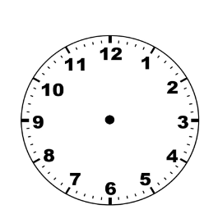
What time is it?
16 minutes past 1

Slide 6
What time is it?
half past 2

Slide 7
What time is it?
half past 12

Slide 8
What time is it?
19 minutes to 1

Slide 9
What time is it?
4 minutes past 12

Slide 10
What time is it?
23 minutes past 10

Slide 11
What time is it?
5 minutes to 9

Slide 12
midday
a.m
ante
meridiem
before midday
Italy
p.m
post
meridiem
Latin
after midday

Slide 13
eat breakfast
going to bed
wear pyjamas
What do you do at 8 o’clock?
getting out of bed
listening to bedtime story

Slide 14
a.m
p.m
There are two 8 o’clocks in the day.
The hour hand goes round the clock two times a day .

Slide 15
What words and phrases help us to understand the time of day we are discussing?
evening
morning
midday
p.m
noon
afternoon
midnight
a.m

Slide 16
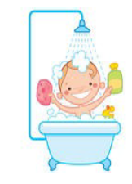
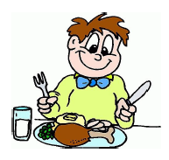
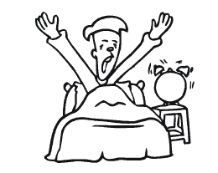
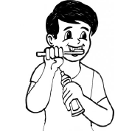
5 minutes past 7
quarter to 8
half past 6
10 minutes to 6
a.m
a.m
p.m
p.m

Slide 17
Independent task
Write a sensible time for these events. Remember to use a.m or p.m.
Decide whether these events happened before midday (a.m) or after midday (p.m)
The sun rose at ___________________
Skye went to school at 9 o’clock _____
I go to bed at ___________________
Lewis went home at 3 o’clock _____
I went swimming at ___________________
Maria practised her recorder at 4 o’clock _____
I had lunch at ___________________
Amanda had her lunch at half past twelve _____
I had breakfast at ___________________
Michael tidied his room at twenty past five _____
The moon shone through Tom’s window at 3 o’clock _____

Slide 18
Pause the video to complete your task
Resume once you’re finished

Slide 19
Independent task
Write a sensible time for these events. Remember to use a.m or p.m.
Decide whether these events happened before midday (a.m) or after midday (p.m)
The sun rose at 5 o’clock a.m.
Skye went to school at 9 o’clock a.m.
I go to bed at 8 o’clock p.m
Lewis went home at 3 o’clock p.m.
I went swimming at 11 o’clock a.m
Maria practised her recorder at 4 o’clock p.m.
I had lunch at 1 o’clock p.m.
Amanda had her lunch at half past twelve p.m.
I had breakfast at half past seven a.m.
Michael tidied his room at twenty past five p.m.
The moon shone through Tom’s window at 3 o’clock a.m

Slide 20
Share your work with Oak National
If you'd like to, please ask your parent or carer to share your work on Instagram, Facebook or Twitter tagging @OakNational, @LauraBehan21 and #LearnwithOak

Slide 21
Now complete the quiz!

