Slide 1
Reading analogue time to the nearest minute
Mathematics
Mrs Behan

Slide 3
Lesson Agenda
Spot the mistake
Read the scale to nearest minute
Practise activity
Independent task and review

Slide 4
You will need...
Pencil or pen
Paper

Slide 5
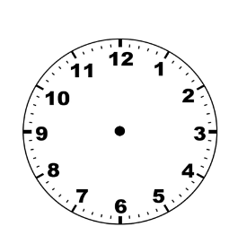
What time is it?
quarter past 1

Slide 6
What time is it?
half past 3

Slide 7
What time is it?
half past 11

Slide 8
What time is it?
quarter to 1

Slide 9
What time is it?
ten past 12

Slide 10
What time is it?
twenty five past 10

Slide 11
What time is it?
twenty to 9

Slide 12
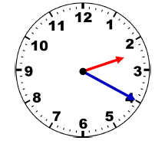
Spot the mistake
The minute hand indicates 4 past.
The hour hand indicates between between 2 o’clock and 3 o’clock.
Therefore, I know the time is four past two.

Slide 13
Spot the mistake
The minute hand indicates 4 past.
The hour hand indicates between between 2 o’clock and 3 o’clock.
Therefore, I know the time is four past two.
twenty past 2

Slide 14
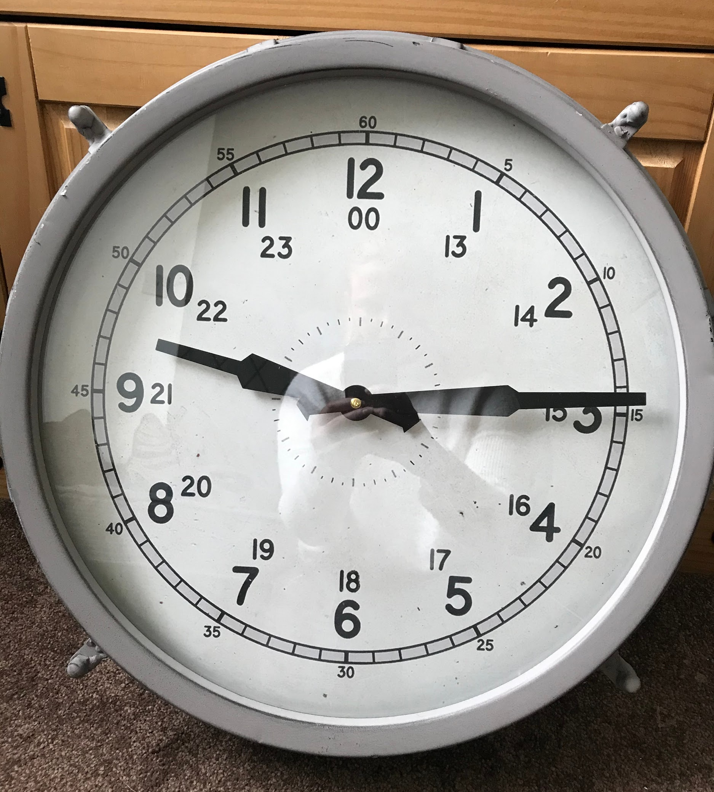
analogue
digital
Source: Mrs Behan images

Slide 26
Read the time to the nearest minute

Slide 27
Read the time to the nearest minute
21 minutes past 1
26 minutes past 10
7 minutes past 12

Slide 28
10 minutes to _____.
1 minute to _____.
2 minutes to _____.
5 minutes to _____.
25 minutes to _____.

Slide 32
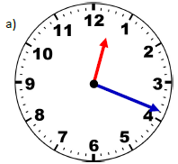
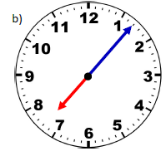
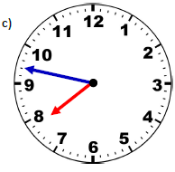
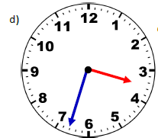
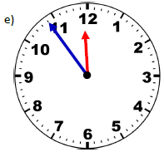
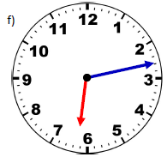
Independent task
Use what you have learned so far in this unit to help you tell the time to the nearest minute.
Remember to be careful about how you count the ‘minutes to’ times as these can be slightly trickier than ‘minutes past’ times.

Slide 33
Pause the video to complete your task
Resume once you’re finished

Slide 34
Independent task
Use what you have learned so far in this unit to help you tell the time to the nearest minute.
Remember to be careful about how you count the ‘minutes to’ times as these can be slightly trickier than ‘minutes past’ times.
19 minutes past 12
7 minutes past 7
13 minutes to 8
27 minutes to 4
6 minutes to 12
13 minutes past 6

Slide 35
Share your work with Oak National
If you'd like to, please ask your parent or carer to share your work on Instagram, Facebook or Twitter tagging @OakNational, @LauraBehan21 and #LearnwithOak

