Slide 2
Sensational Settings
What is a setting?
A setting is where and when the story takes place. An author will use descriptive language to describe the setting to the reader.
Read the two descriptions below. Which description do you think is better and why?
I was sitting on the top deck of the boat at night time. It was really cold.
OR
The icy cold air took my breath away as I opened the door to begin my climb to the top deck of the boat. Sitting on the freezing cold deck chair I pulled on my thick woolen blanket. I looked towards the dark sky and started to count the stars. It was going to be a long cold wait.

Slide 3
Sensational Settings
Why do I need to write a descriptive setting?
A descriptive setting helps to build the reader’s interest. It allows the reader to start to build a picture in their mind of what is happening.
The large white house on the corner of Edmond Street had been empty for as long as I could remember. The tall gates, which were once black, had lost most of their paint and were slowly rusting away. Inside the gates, weeds crawled over every surface revealing more signs of neglect.
Where is this story set?
What words does the author use to interest the reader?

Slide 4
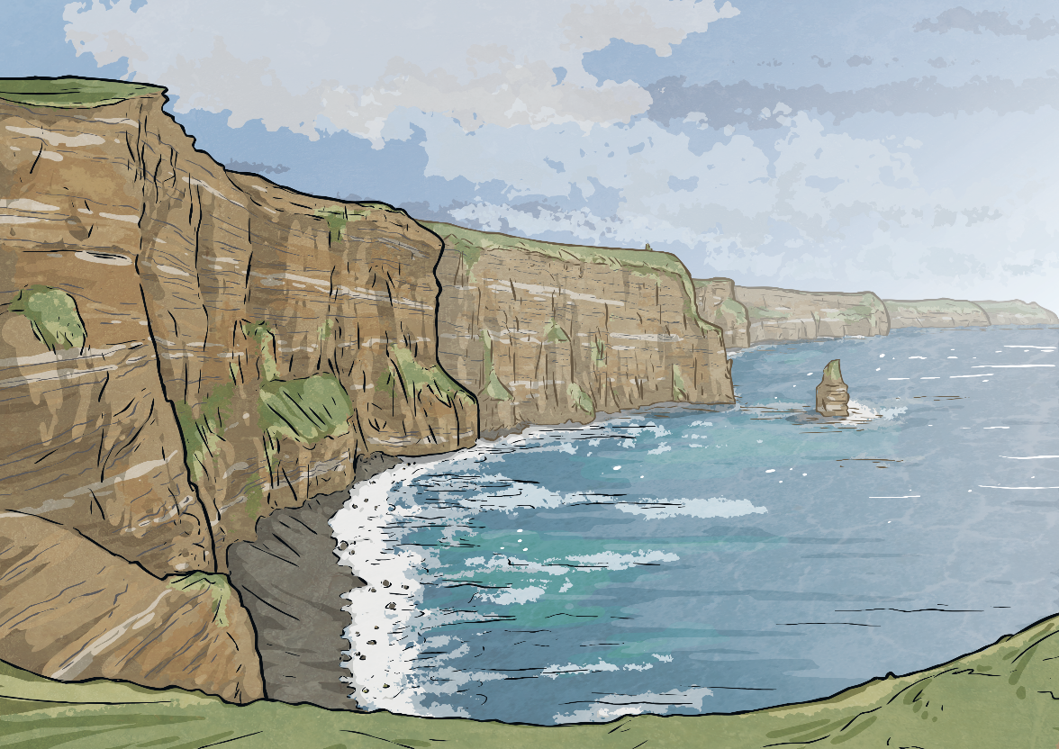
Sensational Settings
An author will paint a picture in the reader’s mind by using descriptive language and interesting adjectives.
How would you describe the Lagoon?
What adjectives would you use to describe the water?

Slide 5
One example could be:
For many years, the clear turquoise waters of the Caribbean were one of the most dangerous places to be. Ships carrying the Jolly Roger flag lurked in the deep waters ready to pounce.

Slide 6
Can you use descriptive language to write about this setting?

Slide 7
Can you use descriptive language to write about this setting?

Slide 8
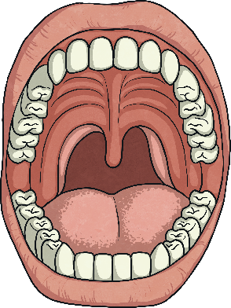
Sensational Settings
Often writers use the Five Senses to describe the setting to their reader.
The author will describe what can be:
Touched
Smelt
Heard
Tasted
Seen

Slide 9
Can you use your 5 senses to write about this setting?
What does it smell like?
What can you hear?
What can you see?
What can you taste?
What can you touch?

Slide 10
The Autumnal leaves crunched under my feet as I ran through Blackwood Forest. The earthy smell of the forest floor filled my nostrils. I stopped to catch my breath. Listening carefully, I heard the birds singing from the topmost tree branch. I reached out my left hand allowing my fingers to brush against the smooth, wet leaves.

Slide 11
Can you use your 5 senses to write about this setting?
What does it smell like?
What can you hear?
What can you see?
What can you taste?
What can you touch?

Slide 12
Can you use your 5 senses to write about this setting?
What does it smell like?
What can you hear?
What can you see?
What can you taste?
What can you touch?

